Slide 1
Password security

Slide 2
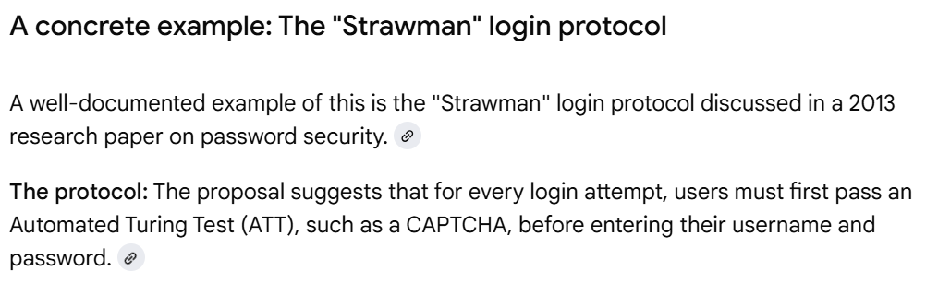
A Strawman proposal
The most basic approach at building a password system might be to use a file that stores usernames and passwords. Such a (colon-delimited) file might look as follows:
john:automobile
mary:balloon
joe:wepntkas
When a user tries to log in, you could simply locate the corresponding username in the file, and do a string comparison to determine whether the password that the user enters matches the one in the password file.

Slide 3
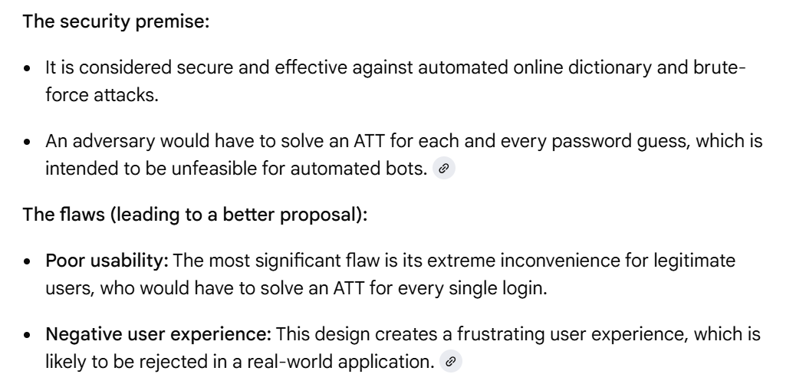

Slide 4
Hashing
Instead of storing passwords, you could store an encrypted version of the passwords, and decrypt the passwords in the file whenever you need to check them. To do so, you could use a symmetric encryption algorithm, such as AES (Advanced Encryption Standard). You would need to keep track of a key used to encrypt the passwords, and then you would need to determine where to store the key.
Instead of two-way, symmetric encryption, it’s better to have a mechanism that allows you to store an “encrypted” version of the password in the file, and lets you verify the password that the user enters upon login. You really don’t need to decrypt the password so long as you can verify that the user typed in the correct one. When the user enters a password in an attempt to log in, you can encrypt the user-entered password and compare it to the one in the file. What you need is sort of a “one-way encryption,” in which you can only encrypt the user’s password, but are never able to decrypt the version of the password stored in the password file. If you store only one-way encrypted passwords in the password file, even if an attacker were to get hold of the password file, he would not be able to decrypt any of the users’
passwords.

Slide 5
To help you securely implement a password file, a more suitable cryptographic primitive than two-way, symmetric encryption is a one-way hash function. A hash function, h, takes a string p as input, and produces h(p). Due to the nature of how a hash function works, it is computationally infeasible to determine p from h(p). Some commonly used hash functions are SHA-1 and MD5. While SHA-1 and MD5 are commonly used, there have been recent attacks against them, and it is advisable to use hash functions such as SHA-256 and SHA-512 instead.
An example of a password file that stores one-way hashed passwords is the following:
  john: 9Mfsk4EQh+XD2lBcCAvputrIuVbWKqbxPgKla7u67oo=
  mary: AEd62KRDHUXW6tp+XazwhTLSUlADWXrinUPbxQEfnsI=
  joe: J3mhF7Mv4pnfjcnoHZ1ZrUELjSBJFOo1r6D6fx8tfwU=
For each user listed in the preceding password file, a SHA-256 hash of the password is stored.
E.g., instead of directly storing John’s password, “automobile,” in the password file, the file
stores 9Mfsk4EQ... in place of it. When John’s password needs to be checked, the hash of the
password that is entered is computed and compared against the hash in the password file. The
advantage of storing hashed passwords in the password file is that even if an attacker were to
steal the password file, she would not be able to determine that John’s password is
“automobile” just by looking at the file.

Slide 6
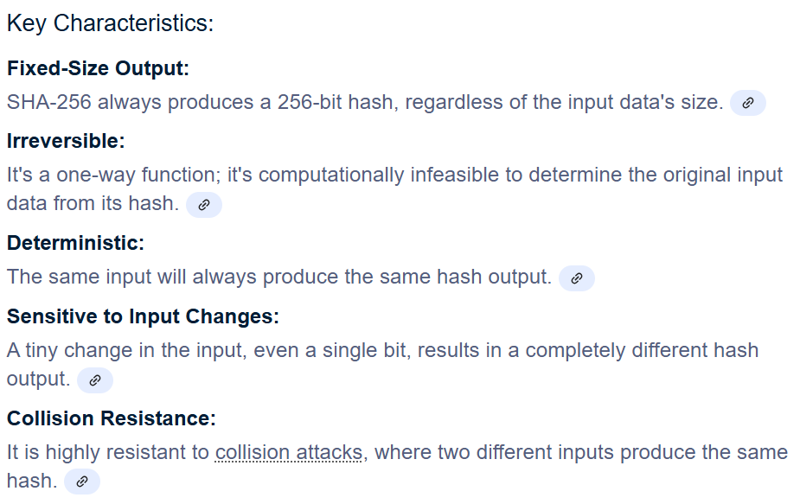
SHA 256
SHA 256 is a part of the SHA 2 family of algorithms, where SHA stands for Secure Hash Algorithm. Published in 2001, it was a joint effort between the NSA (National Security Agency) and NIST (National Institute of Standards & Technology) to introduce a successor to the SHA 1 family, which was slowly losing strength against brute force attacks.

Slide 7
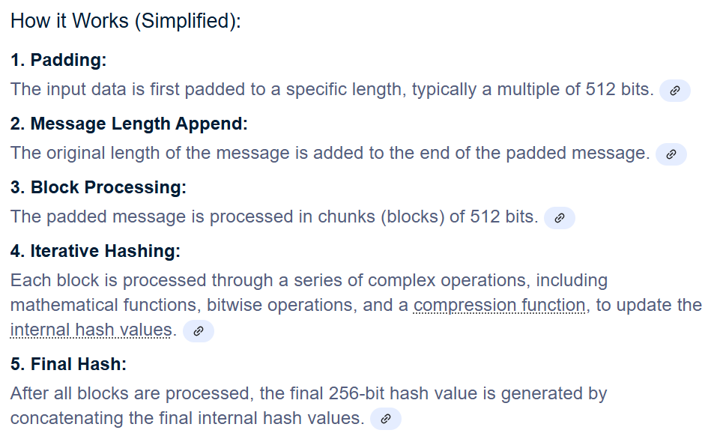

Slide 8
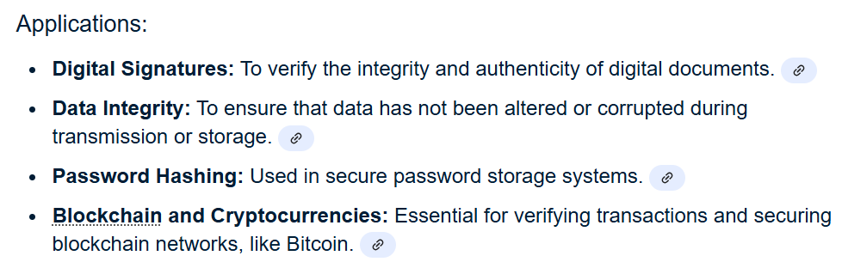
Another important algorithm: SHA 512

Slide 9
Offline dictionary attacks
Even with hashing, given the password file, the attacker can still attempt to determine some users’ passwords due to the fact that most users do not choose good passwords. Often, users will choose passwords that happen to be words in the dictionary, street names, company names, or other well-known strings. A good attacker can easily build a dictionary of words, common street names, common names of companies, and so forth; and use such a dictionary to mount an attack.
If the attacker knows that you are using the SHA-256 hash function to store one-way
encrypted versions of passwords, the attacker can iterate through all the words in a dictionary
and compute the SHA-256 hashes of them. E.g., the attacker’s dictionary might be as follows:
automobile; aardvark; balloon; doughnut
...
The attacker can compute the following dictionary of hashes:
automobile: 9Mfsk4EQh+XD2lBcCAvputrIuVbWKqbxPgKla7u67oo=
aardvark: z5wcuJWEv4xBdqN8LJVKjcVgd9O6Ze5EAR5iq3xjzi0=
balloon: AEd62KRDHUXW6tp+XazwhTLSUlADWXrinUPbxQEfnsI=
doughnut: tvj/d6R4b9t7pzSzlYDJZV4w2tmxBZn7YSmUCoNVx/E=
...

Slide 10
Now, the attacker will simply look for matches between the hashes in the password file
and the hashes that she has computed! For example, since AEd62KRD... appears in the password file as Mary’s hashed password, the attacker knows that “balloon” must be Mary’s
password!
Such an attack is called an offline dictionary attack, and is usually geared at determining
some user’s password. The attacker may not care which user’s password is determined so long as she can determine some user’s password.
The attack is called “offline” because the attacker is not required to actually try username
and password combinations online against a real system to conduct her attack, as she has
possession of the password file.

Slide 11
Salting
Salting is the practice of including additional information in the hash of the password. To
illustrate how salting works and why it makes the attacker’s job harder, we first modify the
structure of the password file. Instead of just having the password file store a username and a
hashed password, we include a third field for a random number in the password file. When a
user—for example, John—creates his account, instead of just storing John’s username and
hashed password, we choose a random number called the salt. Instead of just storing the hash of John’s hashed password, “automobile” in this case, we create a string that is the concatenation of John’s password and the salt, and store the hash of that string in a file.
The entry in the password file may look as follows:
john: ScF5GDhWeHr2q5m7mSDuGPVasV2NHz4kuu5n5eyuMbo=:1515
In the preceding entry, ScF5GDhW... is the hash of John’s password, “automobile,” concatenated
with the salt, 1515. That is, h(automobile|1515) = ScF5GDhW.
Modern password hashing algorithms like Argon2id, bcrypt, and PBKDF2 automatically handle salting.

Slide 12
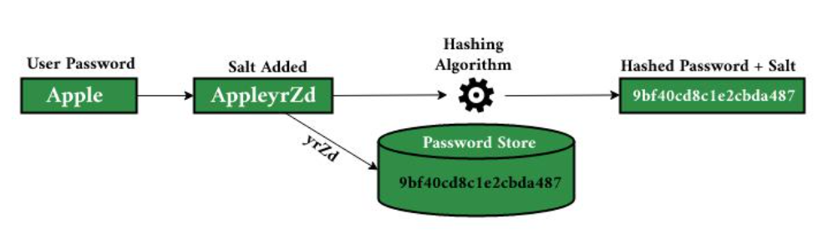
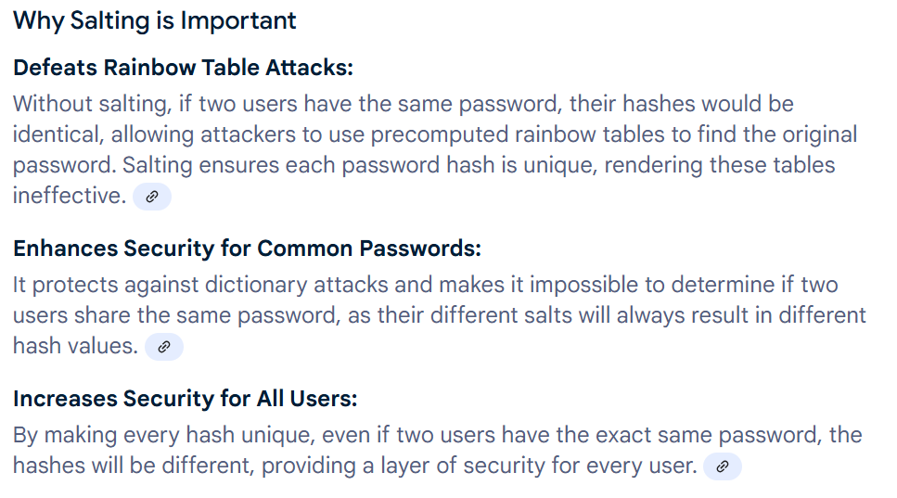

Slide 13
Online dictionary attacks
In online dictionary attacks, the attacker actively tries username and password combinations
using a live, running system, instead of, say, computing hashes and comparing them against
those in some acquired password file. If an attacker cannot acquire a copy of the password file,
and is limited to conducting online dictionary attacks, it at least allows you to monitor the
attacker’s password guessing. If a large number of failed logins are coming from one or more IP addresses, you can mark those IP addresses as suspicious. Subsequent login attempts from suspicious IPs can be denied, and additional steps can be taken to mitigate the online dictionary attack.
Additional password security techniques
Strong Passwords
  It is important to encourage users to choose strong passwords that cannot be found in a dictionary and that are not simple concatenations of dictionary words. Some suggestions for creating strong passwords include making them as long as possible; including letters, numbers, and special characters; and using passwords that are different from those that you have used on other systems. You can also create strong passwords from long phrases.

Slide 14
  However, since some users may not choose strong passwords, it is important to protect the password file from falling into the attacker’s hands, even if salting is used. In older versions of UNIX, the password file used to be readable by all and stored in /etc/passwd. The /etc/passwd file is still present in newer versions of UNIX, but does not store password hashes or salts. Instead, password hashes and salts are stored in a /etc/shadow file that is only accessible to the system administrator and other privileged users.
II. Honeypot Passwords
  To help catch attackers trying to hack into a password security system, you can use simple
  passwords and usernames to attract the attackers. For instance, many systems might have a default username called “guest” that has the password “guest.” You do not expect normal users to use this guest account. You can set up your system such that if the attacker tries to log in using a default password for the guest user, you can set that as a trigger so that your system administration staff can be notified. When somebody tries logging into it, you know that it may be an indication that an attacker is trying to break into your system. Once the system administration staff is notified that somebody might be trying to break into the system, you can then take action to identify which IP address the attacker is coming from. You can also allow the attacker to continue using the guest account to help you learn more about what the attacker is trying to get at.

Slide 15
III. Password filtering
  Since most users might not like to have passwords chosen or even suggested for them, you
  could let the users choose passwords for themselves. However, if a user chooses a password
  that is in the dictionary or identified by your password security system as easy to guess, you
  could then filter that password and require the user to choose another one.
Aging passwords
  Even if the user chooses a good password, you might not want the user to use that password
  for the entire time that they are going to use your system. Every time that the user enters the
  password, there is a potential opportunity that an attacker can be looking over the user’s
  shoulder. Therefore, you could encourage users to change their passwords at certain time
  intervals—every month, every three months, or every year, for example. Another way to “age”
  passwords is to only allow each password that the user chooses to work a certain number of
  times.

Slide 16
V. Pronounceable passwords
  Password security system designers noticed that users sometimes want to choose dictionary
  words because they are easy to remember. Hence, they decided to create pronounceable
  passwords that may be easy to remember because users can sound them out, but would not
  be words in the dictionary. Pronounceable passwords are made up of syllables and vowels
  connected together that are meant to be easy to remember. Some examples of pronounceable
  passwords—generated by a package called Gpw (www.multicians.org/thvv/gpw.html)—are
  ahrosios, chireckl, and harciefy.
VI. Limited login attempts
  Users can be given a limited number of login attempts before you disable or lock their account. The advantage of limited login attempts is that if an attacker is trying to break into a particular user’s account, he will only be given a fixed number of tries. The downside of using this approach is that if a legitimate user happens to incorrectly enter her password just a few times, then her account will be locked. A legitimate user may then need to call a system administrator or customer service number to have her password reset. Another disadvantage is that it gives an attacker the ability to launch a DoS attack against one or more accounts. For instance, if the attacker gets a lot of usernames and tries a couple of random guesses for each username’s password, the attacker can end up locking a large fraction of the user accounts in a system.

Slide 17
VII. Artificial delays
  You could introduce increasing artificial delays when users attempt to log into a system over
  the network. The first time that a user attempts to log in, you present the user with the username and password prompt immediately. If the user enters an incorrect password, you can
  have the system wait 2 seconds before allowing the user to try again. If the user still gets the
  username or password wrong, you can have it wait 4 seconds before allowing that user to try
  again. Generalizing, you can exponentially increase the amount of time before letting a particular
  client with a particular IP address try to log into your network.
  For regular users, this might introduce an inconvenience. If a regular user happens to get
  his password wrong three times, he may have to wait on the order of 8 seconds before being
  allowed to try again. An online password-guessing attack against a system that introduces artificial delays may require many IPs to try many different combinations of a user’s password before the attacker gets one right. By introducing artificial delays into the system, you decrease the number of different guesses that the attacker can try in a given unit of time.

Slide 18
VIII. Last login
  Another enhancement that you can employ to increase the security of your password system
  is that every time a user logs in, you can display the last date, time, and potentially even location
  from which the user logged in. You could educate users to pay attention to when and where their last login attempts were from. If a user ever notices an inconsistency between when and where she last logged in and when and where the system reported that she last logged in, she can notify the system administration staff or customer service.
Image authentication
  One recent attempt at making password systems less susceptible to phishing attacks has been
  to use images as a second factor in conducting authentication. Upon account creation, a user
  is asked to choose an image in addition to a username and password. When the user is presented with a login page, the user is asked for his username first. Upon entering a username, the user is shown the image that he chose when signing up, in addition to being prompted for his password. The intent of using image authentication is to prevent the user from providing his password to an impostor web site. While an impostor web site may be able to spoof a legitimate web site’s home page, the impostor will not know what image a user has selected. Hence, after a user enters his username into a web site that uses image authentication, he should not enter his password if the web site does not display the same image that he selected when he signed up.

Slide 19
X. One-time passwords
  In a one-time password system, every time a user logs in, the user is expected to log in
  with a different password. The one-time password system used to be implemented by giving
  users lists of passwords. OTP cards, Smart cards, etc. keep track of the OTPs as it is cumbersome for users to remember.

Slide 20
Thank you
Dr. Rachaita Dutta
Assistant professor
Dept. of mca
  9007223301
  rachaitadutta@my.amrita.edu

